Slide 1
Aspect-Aware Multimodal Summarization for Chinese E-Commerce Products
Source: AAAI-20
Speaker: Tzu-Yun, Chien
Advisor: Jia-Ling, Koh
Date: 2020/9/4

Slide 2
Outline
01
Introduction
03
Experiment
02
Method
04
Conclusion

Slide 3
Outline
01
Introduction
03
Experiment
02
Method
04
Conclusion

Slide 4
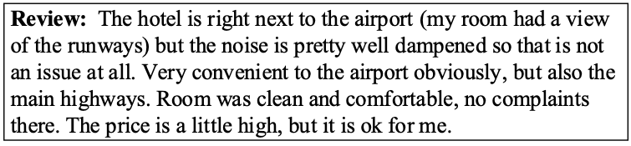
Summarization
Long
The hotel is in a great location that near by airport, and the room is very clean and comfortable. However, the price is a little high.
Short
4

Slide 5

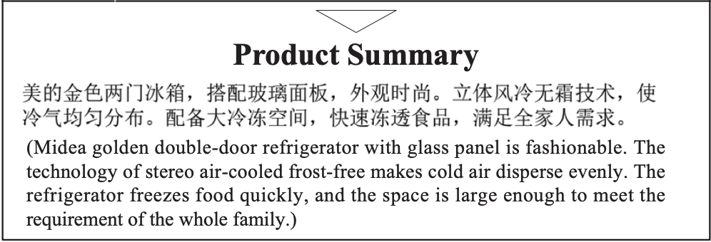
Product Summarization
5

Slide 6
Aim(s)
Problem:
1. Do not use the products’ visual information -> first impression
2. Do not consider the product aspects -> selling point
Solution:
1. Aspect-aware multimodal summarization model for E-commerce product
2. Adopt three strategies to improve importance, non-redundancy, and readability, respectively.
6

Slide 7
Outline
01
Introduction
03
Experiment
02
Method
04
Conclusion

Slide 8
Baseline
Pointer-Generator Network

Slide 9
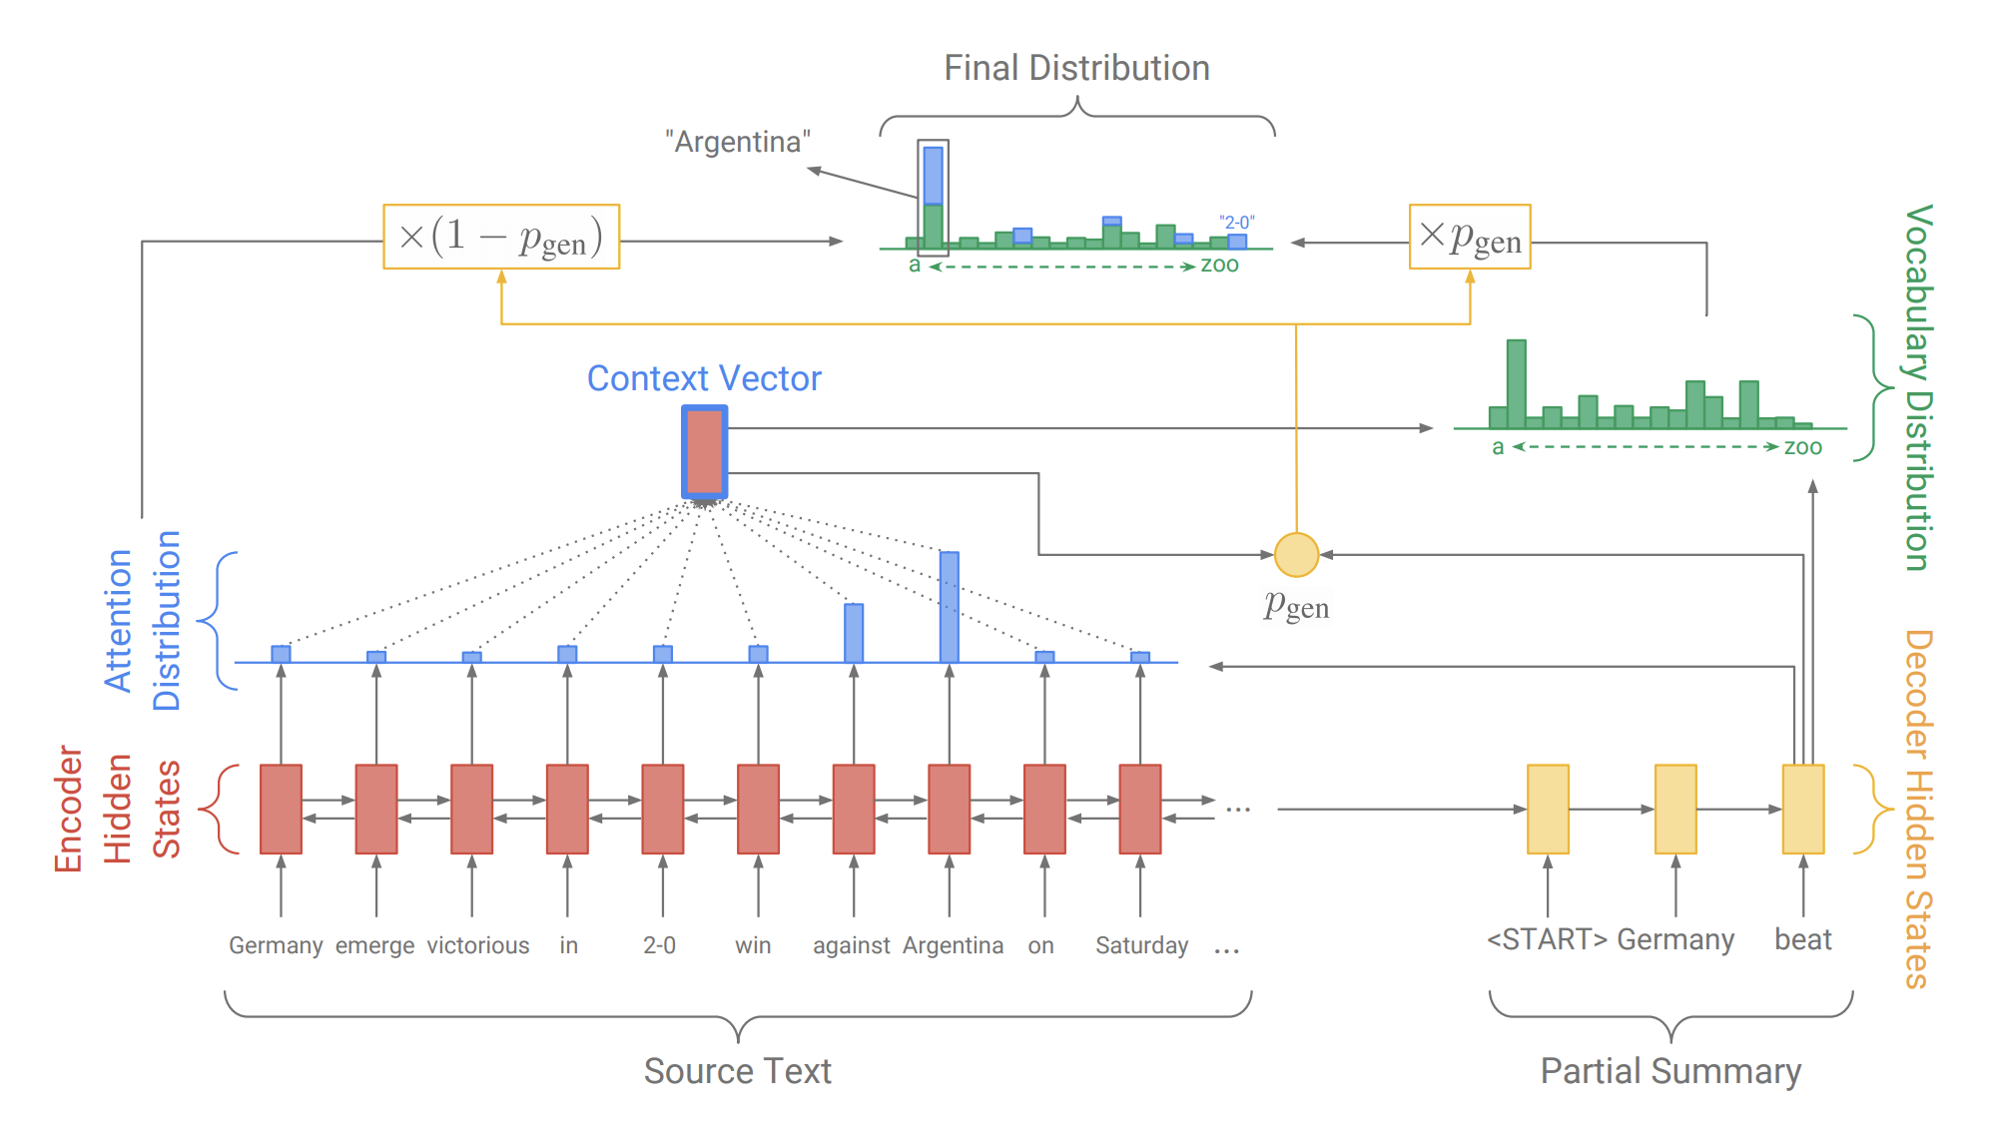
Pointer-Generator Model
9

Slide 10




Encoder/Decoder Hidden State
$$h_{i}$$
$$s_{t}$$
$$x_{i}$$
$$y_{t}$$
10

Slide 11
Attention Distribution
$$e_{t,i}=u_{a}^{T} tanh(W_{a}h_{i}+V_{a}s_{t}+b_{a})$$
$$a_{t}=softmax(e_{t})$$
$$s_{t}$$
11

Slide 12
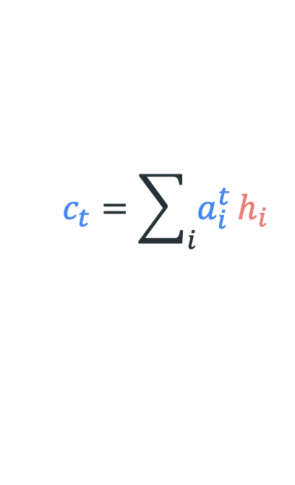
Context Vector
$$c_{t}=\sum_{i}{a_{i}^{t}}h_{i}$$
$$s_{t}$$
12
Notes:
The context vector, which can be seen as a fixed size representation of what has been read from the source for this step

Slide 13
Vocabulary Distribution
$$P_{vocb}=softmax(V^{′}(V\left[s_{t},c_{t}\right]+b)+b^{′})$$
13

Slide 14
Generation Probability
$$p_{gen}=sigmoid(w_{d}^{T}c_{t}+u_{d}^{T}s_{t}+v_{d}^{T}y_{t}+b_{d})$$
14

Slide 15


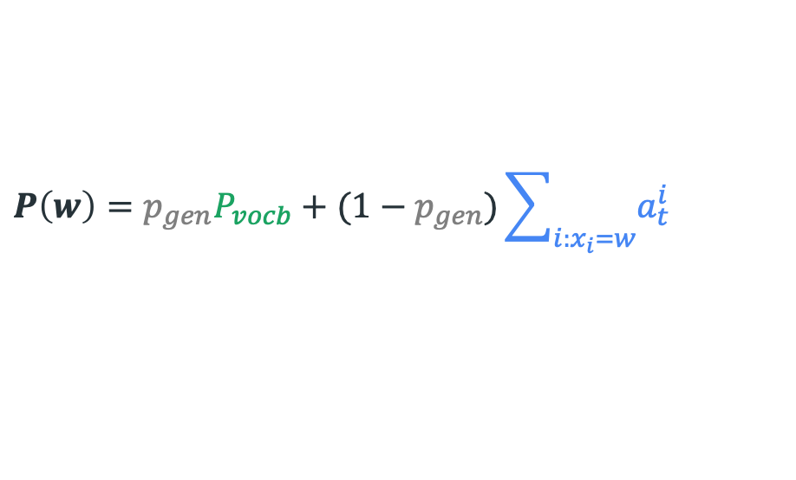
$$copy$$
$$generate$$
$$P\left(w\right)=p_{gen}P_{vocb}+(1−p_{gen})\sum_{i:x_{i}=w}{a_{t}^{i}}$$
15

Slide 16
Multimodal Pointer-Generator Network
(MMPG)

Slide 17
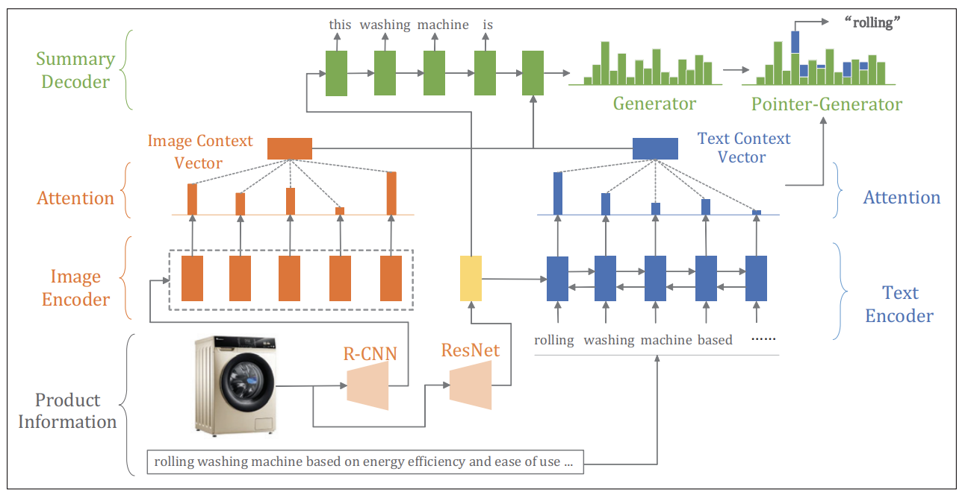
16

Slide 18
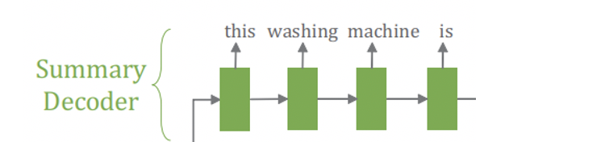
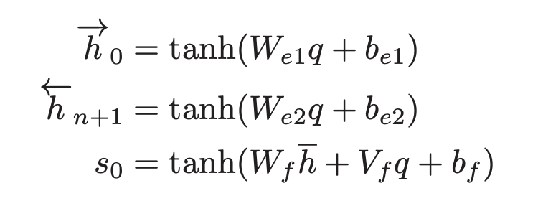

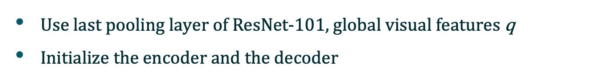


Hidden state initialization
Use last pooling layer of ResNet-101, global visual features q
$Initialize the encoder and the decoder$
$$s_{0}$$
$$q$$
$$\overline{h}$$
17

Slide 19
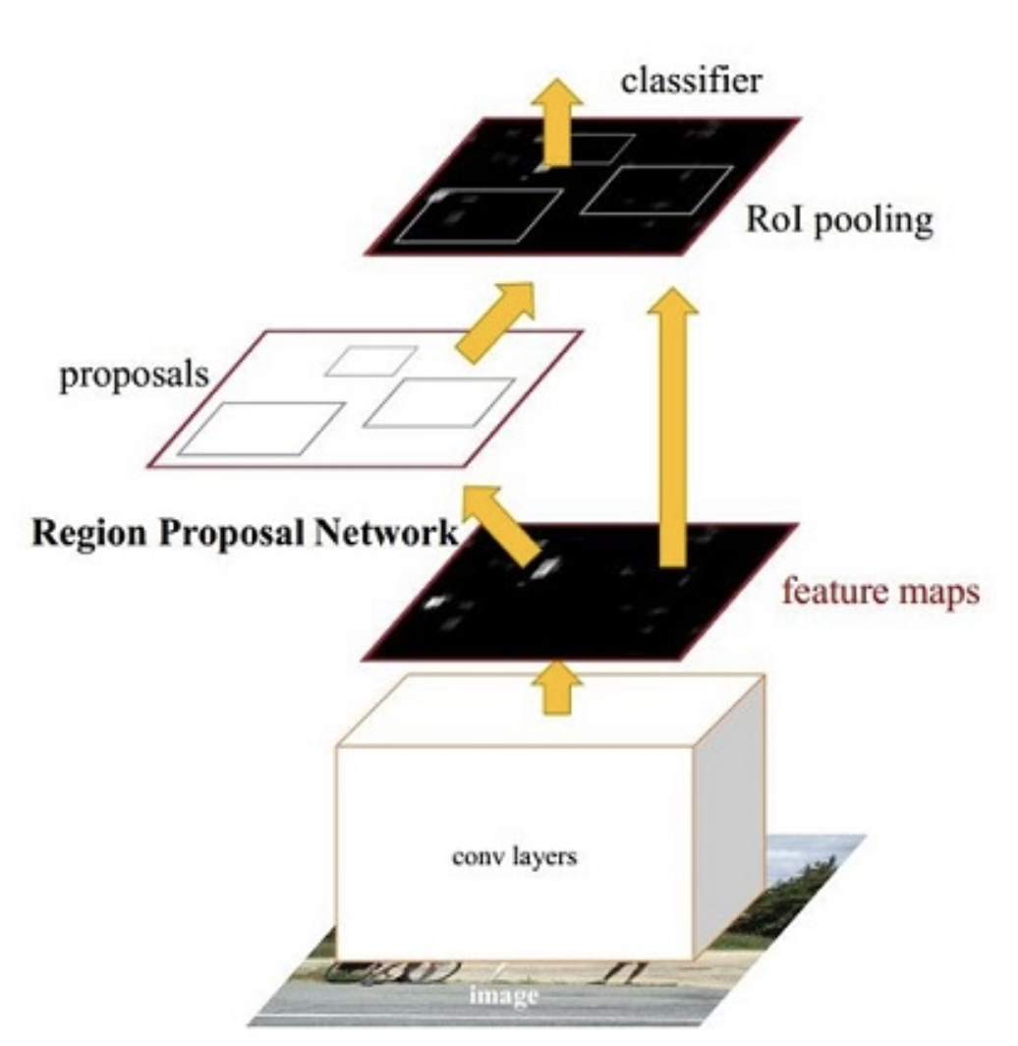


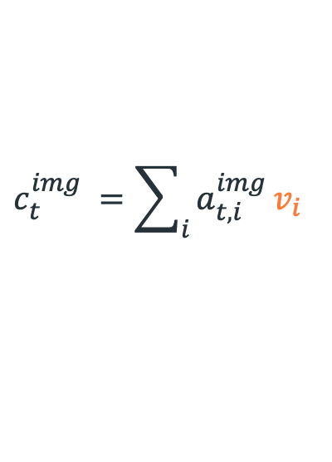

Visual Context Vector
Use ROI pooling layer of Faster-RCNN
$$v_{i}$$
$$s_{t}$$
$$e_{t,i}^{img}=u_{a}^{T} tanh(W_{a}v_{i}+V_{a}s_{t}+b_{a})$$
$$a_{t,i}^{img} =softmax(e_{t,i}^{img})$$
$$c_{t}^{img} =\sum_{i}{a_{t,i}^{img}}v_{i}$$
$$v_{i}$$
18

Slide 20

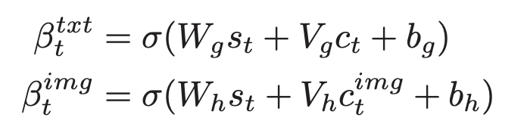

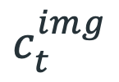
Multimodal Context Vector
$$s_{t}$$
$$c_{t}^{img}$$
$$c_{t}^{}$$
19

Slide 21
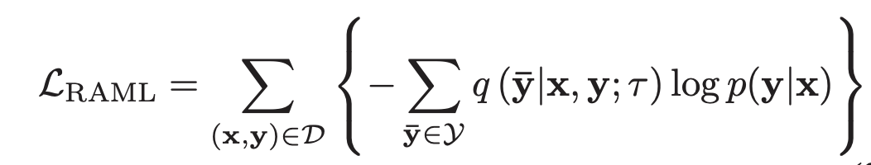
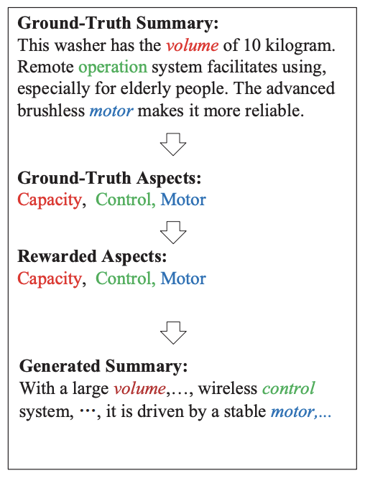
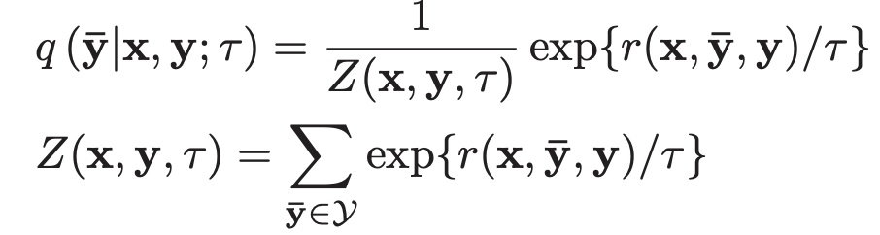
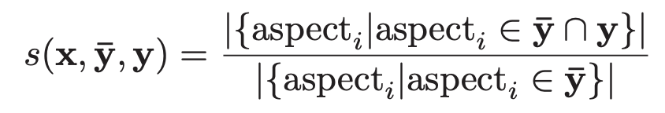
Loss Function
20

Slide 22
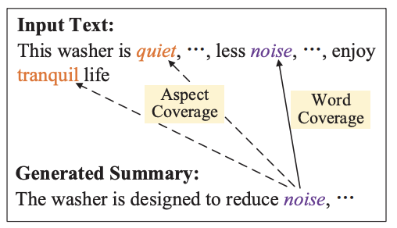
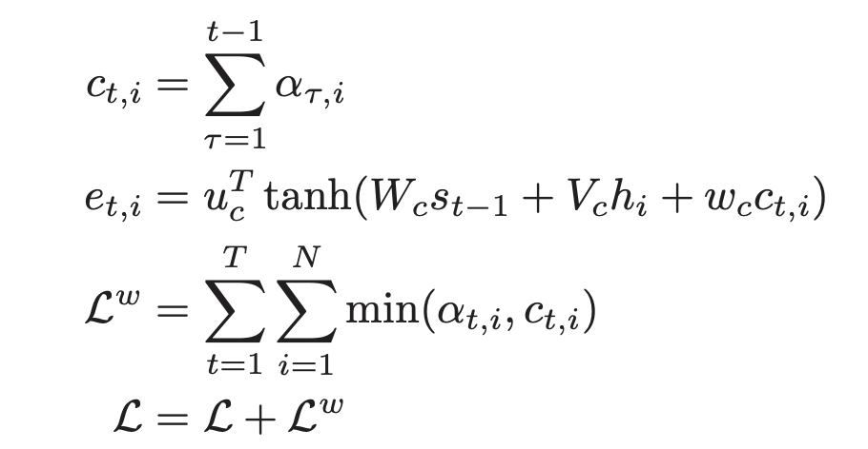
Coverage mechanism
Tracking the attention history
Word-based coverage
21

Slide 23
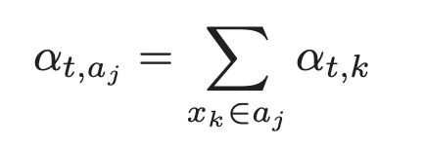
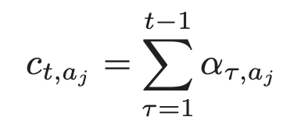

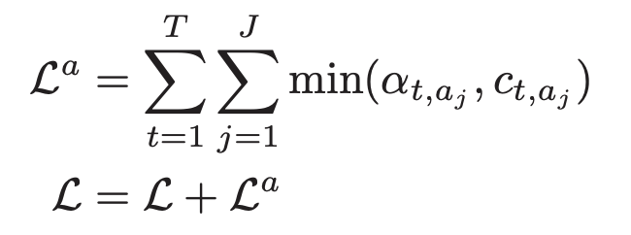
Coverage mechanism
Tracking the attention history
Aspect-based coverage
22

Slide 24
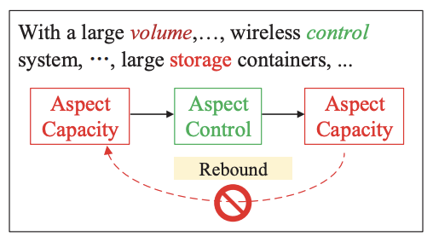


Aspect Coherence & Improving Consistency
Extract the attribute words from product specifications
For example: (material: glass)
23

Slide 25
Outline
01
Introduction
03
Experiment
02
Method
04
Conclusion

Slide 26
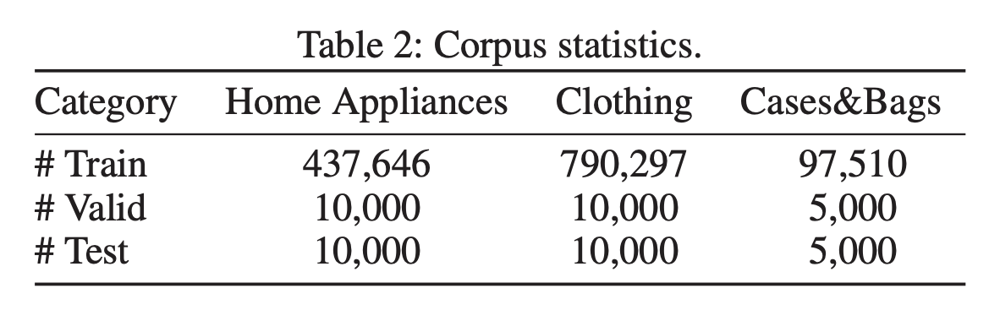
Dataset
10.6 product aspects on average for each category
For each product aspect, 30.9 aspect keywords on average
25

Slide 27
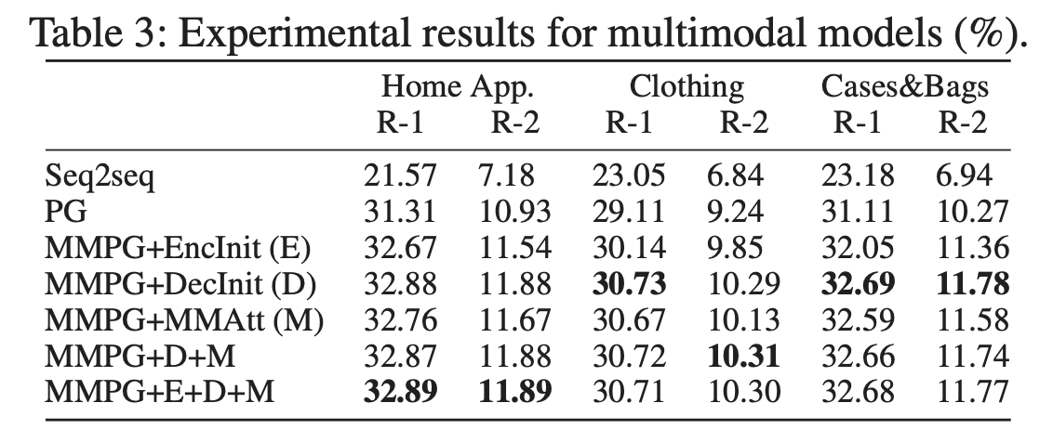
Experimental Results
26

Slide 28
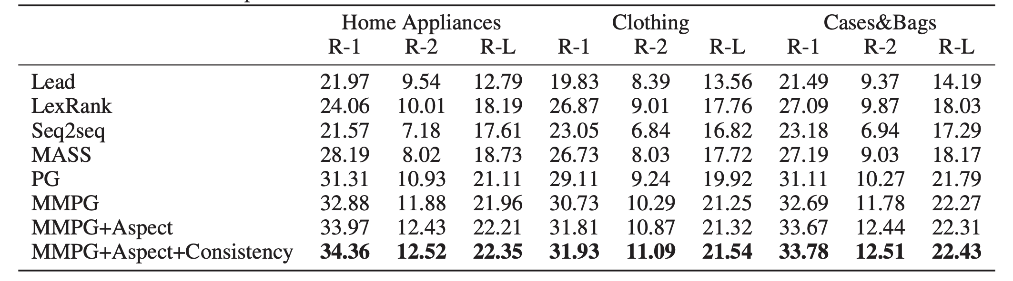
Experimental Results
27

Slide 29
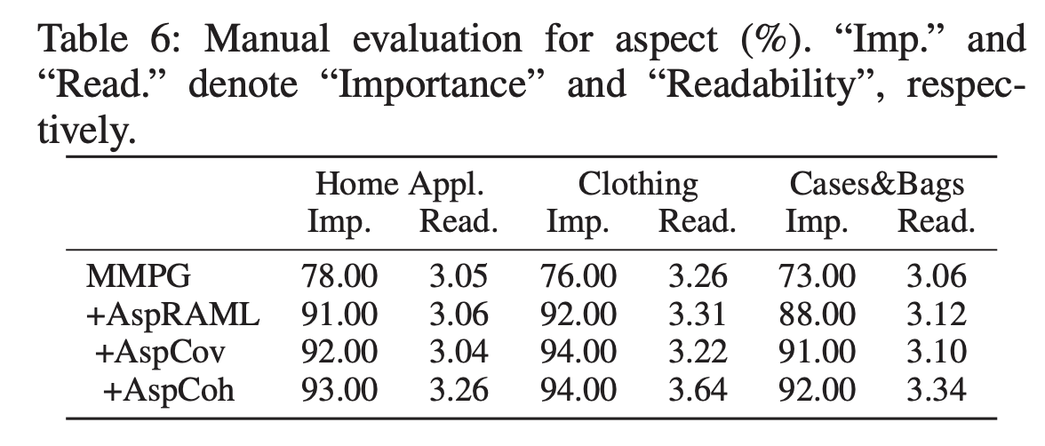
Importance and Readability Analysis
28

Slide 30
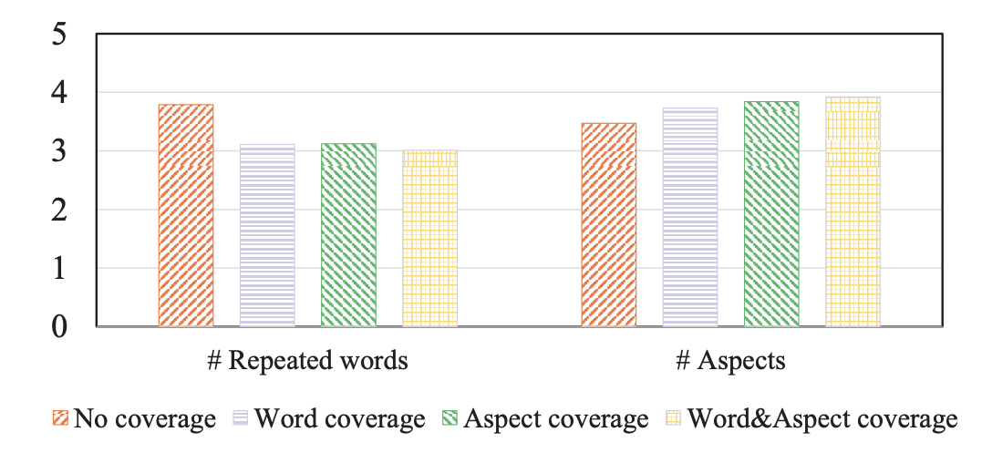
Non-Redundancy Analysis
29

Slide 31
Outline
01
Introduction
03
Experiment
02
Method
04
Conclusion

Slide 32
Conclusion
Propose a multimodal pointer-generator network and use product images in the product summarization task
Adopt aspect RAML training, aspect coverage, and aspect coherence strategies, which aim to improve importance, non-redundancy, and readability, respectively
Construct a large-scale corpus of Chinese e-commerce product summarization
31

